Slide 1

Spatiotemporal Taxi Demand Forecasting with MS-RNN and GNN in NYC Tianqi Wang Supervised by Dr. Ligang He

Slide 2

The Problem
The Taxi Demand-Supply Mismatch
High-Demand Periods
Low-Demand Periods
The Impact of Poor Taxi Demand Forecasting
For Passengers
For Taxi Drivers (Especially Inexperienced Ones)
For Urban Traffic Management
https://pyxis.nymag.com/v1/imgs/351/b04/01b44f3d8dc87ce5c0778efdc629a9b205-10-taxi-in-rain.rsquare.w400.jpg

Slide 3

Complex traffic
Traffic flow exhibits spatial correlations (e.g., interactions between neighboring regions) and temporal dependencies (e.g., peak vs. off-peak periods).
Traditional time-series methods, such as LSTM and GRU, focus solely on temporal patterns while ignoring spatial dependencies, making them ineffective in capturing interactions between adjacent regions.
On the other hand, Graph Neural Networks (GNNs) effectively model spatial relationships but struggle to independently capture temporal dependencies.

Slide 4

What has been done so far?
Recent Advances (Hybrid Models)
Contextualized Spatial-Temporal Network (CSTN)
STGCN (Spatio-Temporal Graph Convolutional Network)
Limitations:
Both model required High computational cost, making real-time deployment challenging.
My project will focus on:
Improve forecasting efficiency and accuracy
Build a lighter model that scalable for real time update without losing performance.

Slide 5
Project management
Develop a spatiotemporal forecasting model for taxi demand prediction.
Combine Multi-Scale RNN (MS-RNN) and Graph Neural Networks (GNN) to capture both temporal and spatial dependencies.
Generate a heat map showing taxi demand distribution and give taxi dispatch suggestion.

Slide 6
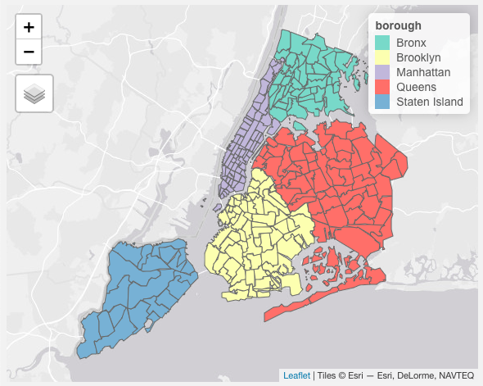
Introduce NYC Taxi Zone

Slide 7
Methodology Overview
Dataset:
TLC Trip Record Data 2021 (New York city)
NYC Taxi Zone Shapefile
NYC traffic data
Hybrid Model
Multi Scale-RNN for temporal learning, GNN for spatial dependencies.
MS-RNN
GNN
Result: model will output predicted passenger demand for each taxi zone in the upcoming hour
Use rolling training strategy, where the training dataset is continuously updated with the most recent data.

Slide 8
Why Do We Need MS-RNN?
1. Predicting taxi demand is complex because different timeframes have different patterns:
Short-term trends (minutes/hours) are highly volatile.
Mid-term trends (days/weeks) follow periodic patterns (e.g., weekdays vs. weekends).
Long-term trends (months) capture seasonal effects
Problem with existing models:
GRU (Gated Recurrent Unit) is too sensitive
LSTM (Long Short-Term Memory) captures mid-term dependencies
Transformers are only great at long-range time data
MS-RNN uses GRU, LSTM and Transformer to process data in different time dimensions
GRU handles short-term fluctuations
LSTM captures mid-term trends
Transformer detects long-term trends

Slide 9
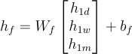
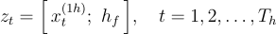
MS-RNN Architecture
Input Taxi Demand Data
Pure Data
(1-hour)
LSTM
(1 day/week)
Transformer
(1-month)
Feature Fusion Layer
GRU(Final Prediction)
Predicted Demand

Slide 10
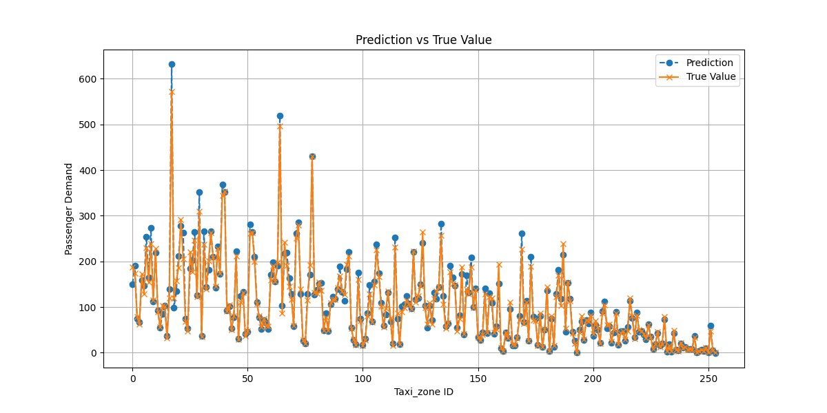
RNN result

Slide 11
Model | Avg MAE | Avg MSE
MS-RNN | 8.01 | 154.55
Pure GRU | 24.56 | 1069.15
Pure LSTM | 13.95 | 355.05
Pure Transformer | 57.72 | 10649.45

Slide 12
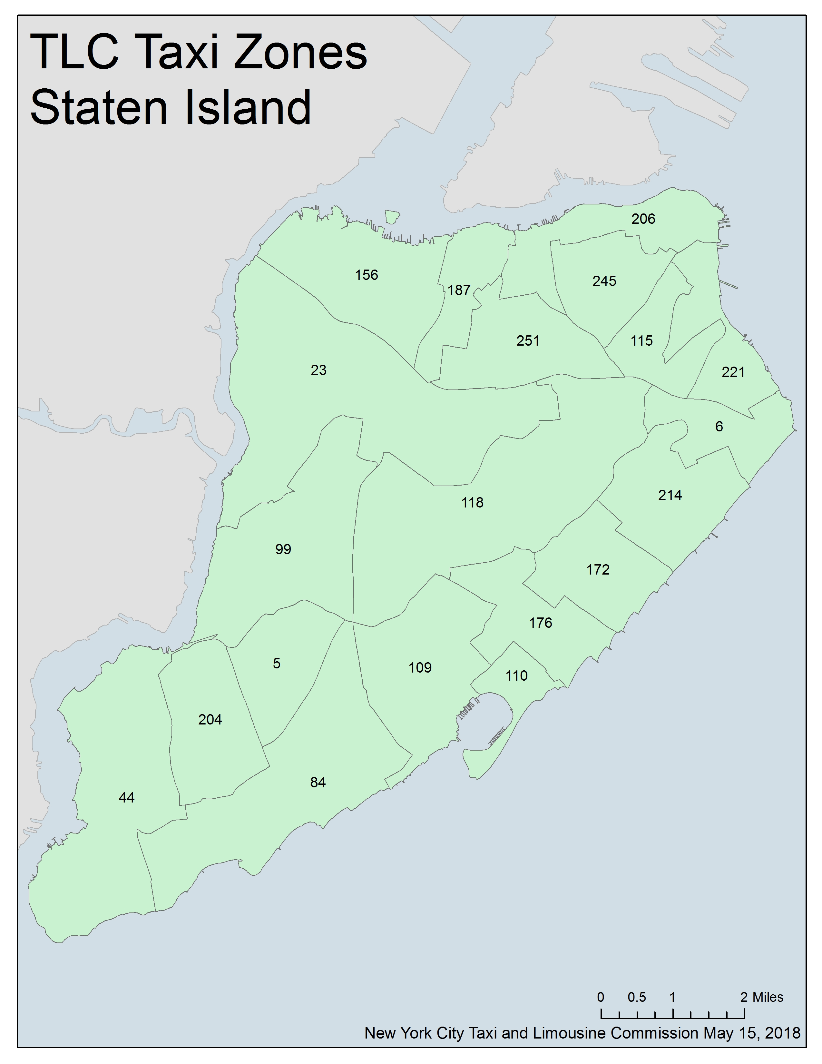
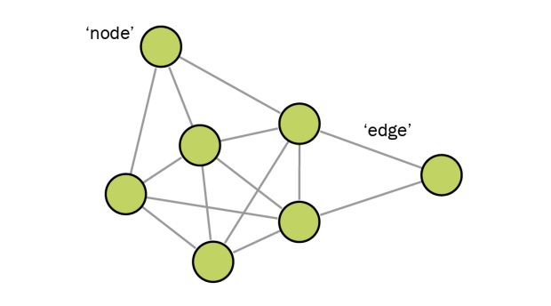
Why Do We Need GNN?
1. Taxi demand is not independent across different regions:
A surge in demand in one area (e.g., a stadium after an event) affects neighboring zones.
Traditional models (LSTM, GRU, Transformer) treat locations as independent, ignoring spatial interactions.
GNN is specifically designed for structured spatial data, like city traffic networks.
Model NYC as a graph
Nodes = Taxi Zones.
Edges = connection between taxi zones
Learns latent relationships between regions, enabling better demand prediction.
44
204
99
84
110
5
109
https://girlstalkmath.com/wp-content/uploads/2019/07/grapth-theory-1.png?w=620
https://www.nyc.gov/html/tlc/images/features/taxi_zone_map_staten_island.jpg

Slide 13
Model Architecture:
Taxi Zones as Nodes
Graph Constructure
(Edges = geographical connection)
Node Features Extraction
(initial GRU Prediction + Traffic data + …)
First GraphSAGE Layer: Aggregates demand info from nearby zones.
Second GraphSAGE Layer: Captures higher-order spatial interactions.
Final Linear Layer(Fully Connect): Outputs Final demand predictions for each zone.
GraphSAGE Layer 1
GraphSAGE Layer 2
Fully Connect Layer

Slide 14
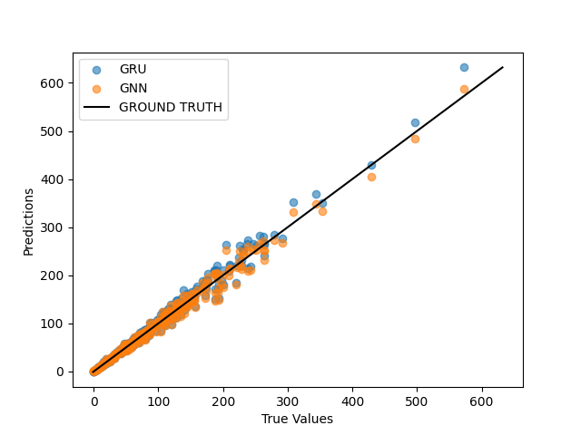
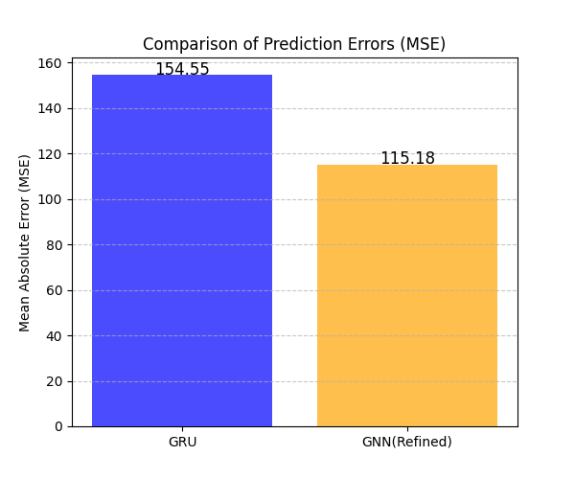
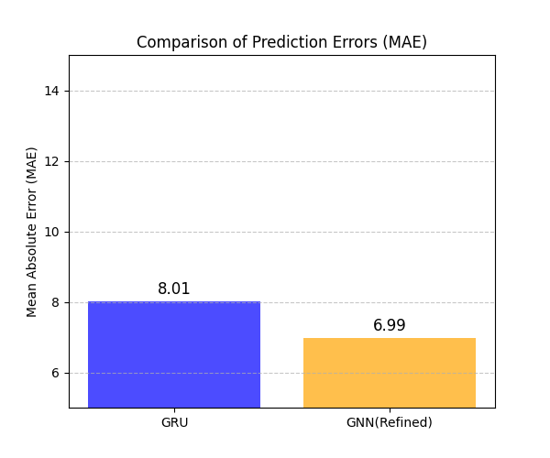
GNN result

Slide 15

Key Takeaways
1. What did we achieve in this study?
Developed a hybrid model (MS-RNN + GNN) for spatiotemporal taxi demand forecasting.
Combined (GRU, LSTM, Transformer), leveraging their individual strengths.
Achieved improved accuracy in predicting taxi demand through GNN.
2. Innovation contribution?
Hybrid model for taxi demand prediction
Multi-scaled RNN
Rolling training strategy

Slide 16
Limitations & Future Work
What can be improved?
Integrate real-time external factors
Use attention mechanisms to optimize RNN model selection further.
Test on different urban environments
Require a high performance GNN to process large graph
Challenges we faced
Data limitations: other feather such us weather or holiday effects were not considered. Minimum time step is an hour.
Computational cost: long-term learning is resource-intensive.
Generalizability: Needs validation on multiple cities beyond NYC.
Granularity Limitation：Only predict passenger demand for each taxi zone rather than a specific location

Slide 17
How can this research be applied in the real world?
For Taxi & Ride-sharing Companies → Optimize fleet management.
For City Planners → Improve urban transportation planning & reduce congestion.
For AI & Mobility Research → Serve as a benchmark for future spatiotemporal modeling studies.

Slide 18

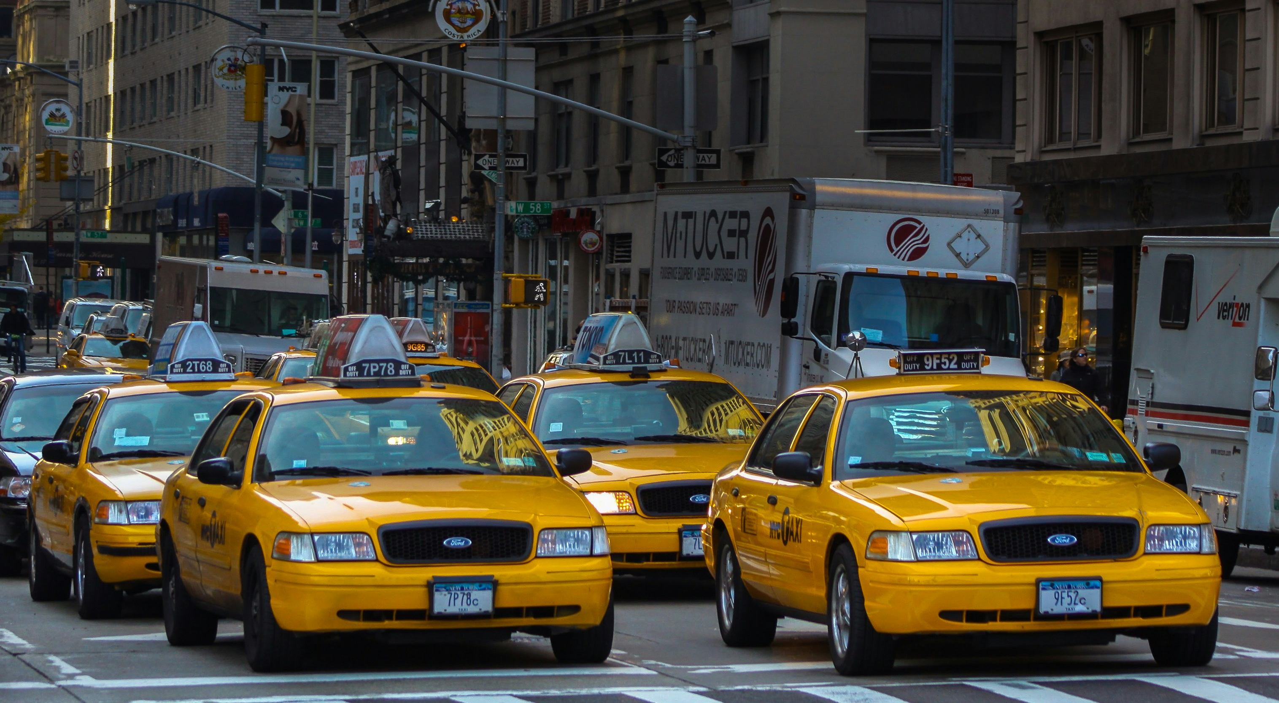
Thank you

Slide 19
Demo

Slide 20

Why predict passenger demand ?
“Utilizing large-scale urban data sets to predict taxi and Uber passengers demand in cities is valuable for designing better taxi dispatch system and improving taxi services.” (Zhao, Khryashchev and Vo, 2020)
This includes Optimize transportation resource allocation, reduce empty driving rates, and improve passenger waiting experience
However, due to the spatiotemporal complexity of traffic flow, traditional prediction methods are difficult to meet actual needs. (Yu, Yin and Zhu, 2018)
https://static.wixstatic.com/media/8bb3dd_c3691e3b18d9458eafec098cbec57e58~mv2.png/v1/fill/w_556,h_370,al_c,q_85,usm_0.66_1.00_0.01,enc_avif,quality_auto/8bb3dd_c3691e3b18d9458eafec098cbec57e58~mv2.png

